Slide 1
React Unstated
Sangeeth Sudhakran
Notes:
ID=d924773e-9a16-4d6d-9803-8cb819e99682 Recipe=text_billboard Type=TextOnly Variant=0 FamilyID=AccentBoxWalbaum_Zero

Slide 2

Introduction
Redux is usually the go-to library to manage state in React, however, depending on how complex your application is, you might not need Redux.
Unstated is an alternative that provides you with the functionality to manage state across multiple components with a Container class and Provider and Subscribe components
This Photo by Unknown Author is licensed under CC BY-SA

Slide 3
Advantages Unstated
Low bundle size.
Easy to implement.
Quick learning curve.
Also can be used in complex applications.
Unstated have 3 points: a container class, a Subscribe component and a Provider component.

Slide 4
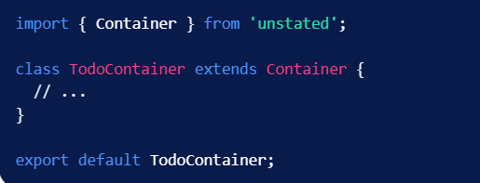
Container
The container extends Unstated’s Container class. It is to be used only for state management. This is where the initial state will be initialized and the call to setState() will happen.

Slide 5
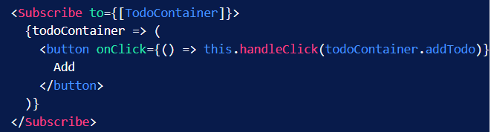
Subscribe
The Subscribe component is used to plug the state into the components that need it. This will update the state of the application and cause the subscribed component to re-render.

Slide 6
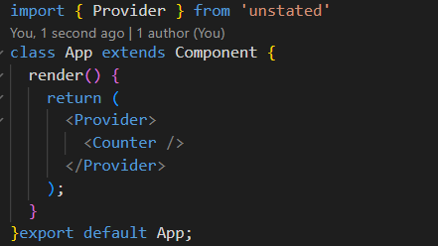
Provider
It will make use of the Provider component to store the container instances and allow the children to subscribe to it.

Slide 7
Conclusion
There are different ways of managing state in React depending on the complexity of your application and Unstated is a handy library that can make it easier.

